Slide 1

IMA Volunteer Service Leader Framework
v
Volunteer Leadership Committee

Slide 2
Conceptual Framework: Components
Personas
Volunteer Deployment Matrix
Volunteer Levels
Considerations
and Guidelines
Training, Content,
and Resources
Volunteer Leadership Committee

Slide 3
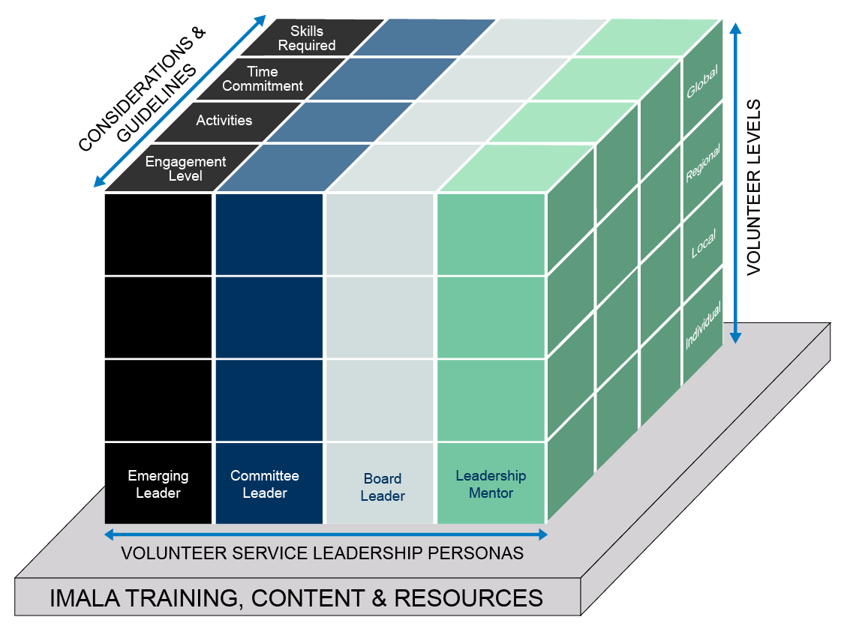
IMA Volunteer Service Leader Framework
b

Slide 4



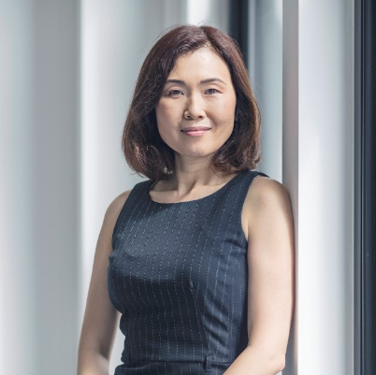

Framework Component: Personas
Four proposed personas covering the key ways in which a volunteer can serve IMA.
Emerging Leader
Committee Leader
IMA member who is
likely in the early stage of volunteerism and shows potential and interest as
a leader.
IMA member serving on an IMA Standing Board Committee, Board Support Committee, or Operational Committee, or participating as a moderator/champion in one of IMA’s Shared Interest Groups.
Board Leader
Leadership Mentor
IMA member serving at a regional or local level:
Chapter Board
Elite Club Leader
U.S. Council Board
ICMA Board of Regents
IMA member who has served as a committee or Board leader and stays engaged to mentor the next generation of IMA volunteer leaders.

Slide 5
Framework Component: Volunteer Deployment Matrix
VOLUNTEER EXPERIENCE
AREAS OF VOLUNTEER INTEREST
Define the reasons why you want to serve
Identify the benefit(s) and/or value you hope to provide to others, to yourself
Determine how you will align with and support IMA core values, mission, and vision
Determine how you will help grow the leadership pipeline
Describe how you will share your time, talent, and expertise with like-minded individuals and professionals
Describe how you will grow your personal and professional network
Identify ways in which you will serve IMA, including but not limited to:
  Speaking or instructing
  Recruiting members
  Helping to retain members
  Growing the leadership pipeline
  Mentoring others
  Reaching out to external audiences and stakeholders about IMA
  Participating in IMA events and programs
  Applying for volunteer leadership roles
GOALS OF VOLUNTEERING
LEADERSHIP EFFORTS
Build a sense of community
Focus on serving others’ needs to help them achieve their goals
Influence individuals, companies, and IMA to be successful
Build a safe, transparent environment suitable for growth and inspiration of others
Provide fiduciary oversight
Understand your volunteer role vs. the role of IMA staff and leadership team
Identify and define the audience(s) you are/will be serving in your volunteer role
Understand the different needs and expectations of each audience you will be serving
Match your strengths and skills to the audience(s) you will serve
The Volunteer Deployment Matrix is designed to be used in conjunction with the Framework Personas to help volunteer leaders determine WHY they want to serve, HOW they want to serve, WHO they want to serve, and WHAT they want to achieve through their service at the various levels of volunteering.

Slide 6
Emerging Leader Persona: Jun, CPA
VOLUNTEER EXPERIENCE
AREAS OF VOLUNTEER INTEREST
0-2 years of volunteering
Campus Influencer
Wishes to volunteer for an organization like
IMA to gain exposure to professionals in the industry with greater knowledge and expertise than his own
Shared Interest Group
Committee on Ethics
ICMA Exam Review Committee
Volunteer personas were created for each of the four types using actual profiles from real IMA members (but names changed for privacy).
GOALS OF VOLUNTEERING
LEADERSHIP EFFORTS
Increase membership, retention, and IMA brand awareness
Serve as a Campus Influencer
Marketing efforts to grow the IMA name domestically and globally
Obtain FMAA certification
Reach out to local businesses and network up to larger businesses to speak with them about the great benefits of the CMA
Earn my own CMA certification and lead others to the CMA

Slide 7
Committee Leader Persona: Rita, CMA, CPA
VOLUNTEER EXPERIENCE
AREAS OF VOLUNTEER INTEREST
3-5 years of volunteering
Committee Member
  IMA Global Awards and Leadership Experience Review Committee
  Chapter and/or U.S. Council Board
Global Board of Directors
Accounting and Finance Conference Program Committee
Committee on Academic Relations
GOALS OF VOLUNTEERING
LEADERSHIP EFFORTS
Give back and share strategic insights from 20+ years of professional experience
Continue learning and growing my own volunteer service leadership skills
Help others in the profession to grow in their careers
Help IMA grow and scale its domestic and
global initiatives

Slide 8
Board Leader Persona (local example): Bina, CMA
VOLUNTEER EXPERIENCE
AREAS OF VOLUNTEER INTEREST
3-5 years of volunteering
Local Board Member
  Chapter President
  Chapter Director-at-Large
  Chapter VP of Membership
Regional Advisory Committee (Europe, China, India, Middle East)
Emerging Issues and Innovation Committee
Shared Interest Group
Campus Influencer
GOALS OF VOLUNTEERING
LEADERSHIP EFFORTS
Give back to others and make a difference on a global scale
Implement forms of social activities for more chapter involvement and volunteer engagement
Organize volunteer-led events to build camaraderie among membership and give professionals and students more opportunities to connect

Slide 9
Board Leader Persona (global example): Marcel, CPA
VOLUNTEER EXPERIENCE
AREAS OF VOLUNTEER INTEREST
5-10 years of volunteering
Global Board Member
  Chair: Global Markets Committee
  Chair: Performance Oversight and Audit Committee
  Liaison to IMA Board Support and/or Operational Committee
Member of local IMA community
Moderator/Champion of IMA Shared Interest Group
Global Board of Directors
Regional Advisory Committee Chair
Committee on Ethics
Volunteer Engagement and Communities Committee
GOALS OF VOLUNTEERING
LEADERSHIP EFFORTS
Ensure IMA stays at the forefront of the profession
Engage in community
Provide fiduciary oversight to IMA
Lead from the front or from the rear, as necessary
Willing to be visible or invisible
Teaming to achieve desired outcomes
Support and inspire membership through senior management

Slide 10
Leadership Mentor Persona: Jamar, CMA, CFM, CPA, CIA, CTP, CFE
VOLUNTEER EXPERIENCE
AREAS OF VOLUNTEER INTEREST
10+ years of volunteering
Global Board Member
  Governance Committee
  Strategic Planning Committee
Regional Board Member
  Local Community Leader
Nominating Committee
IMA Committee and Board Chair
Global Board of Directors
Performance Oversight and Audit Committee
Campus Influencer
GOALS OF VOLUNTEERING
LEADERSHIP EFFORTS
Give back to the profession
Reciprocate support granted to me upon changing careers and receiving credentials
Support IMA’s strategic plan to align with all volunteer opportunities
Author articles on volunteer service
Coach and strengthen Board members and volunteers interested in supporting IMA’s vision and mission
Meet the needs of IMA members

Slide 11

Framework Component: Volunteer Levels
Volunteer leaders can engage with IMA at several different levels, including at more than one level at the same time.
Global Community
Regional
Local
Individual

