Slide 1
Creating an IMA Customer ID
A step by step guide

Slide 2
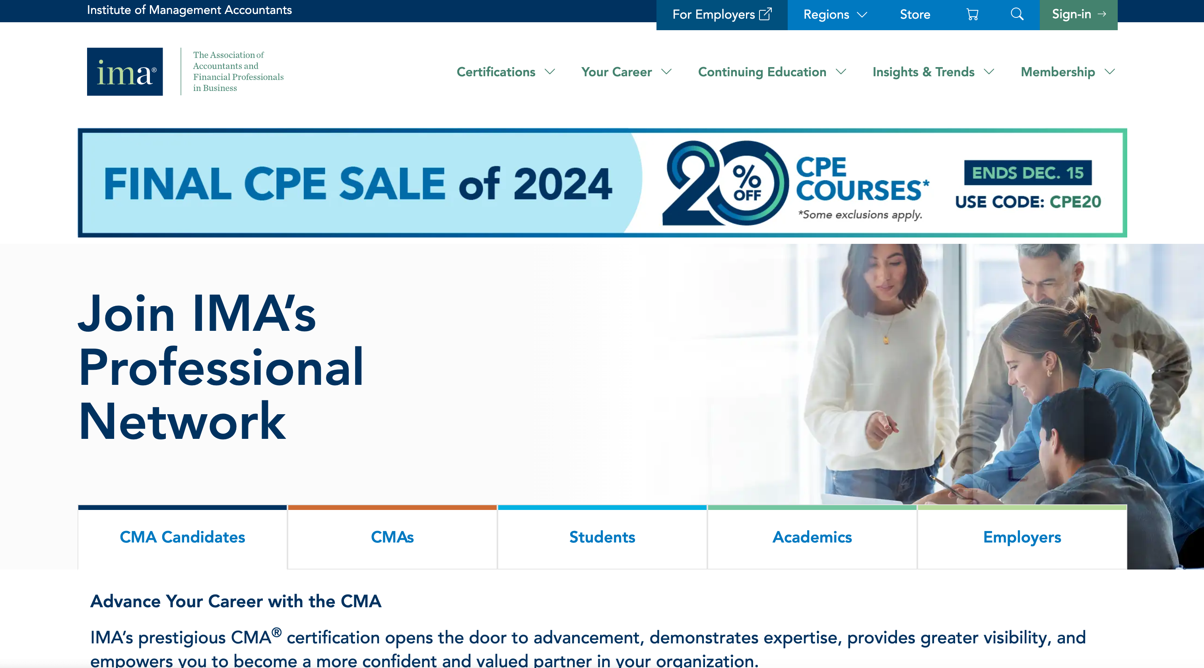
Step 1
Login to IMA’s website www.imanet.org by clicking on the sign-in tab.
Creating an IMA Customer ID | A step by Step guide

Slide 3
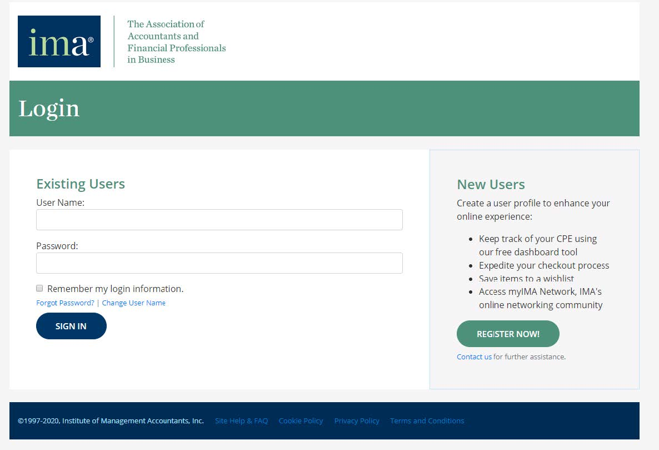
Step 2
Step 2
Go to New User
and click Register Now
Go to New Users and click Register Now.
Creating an IMA Customer ID | A step by Step guide

Slide 4
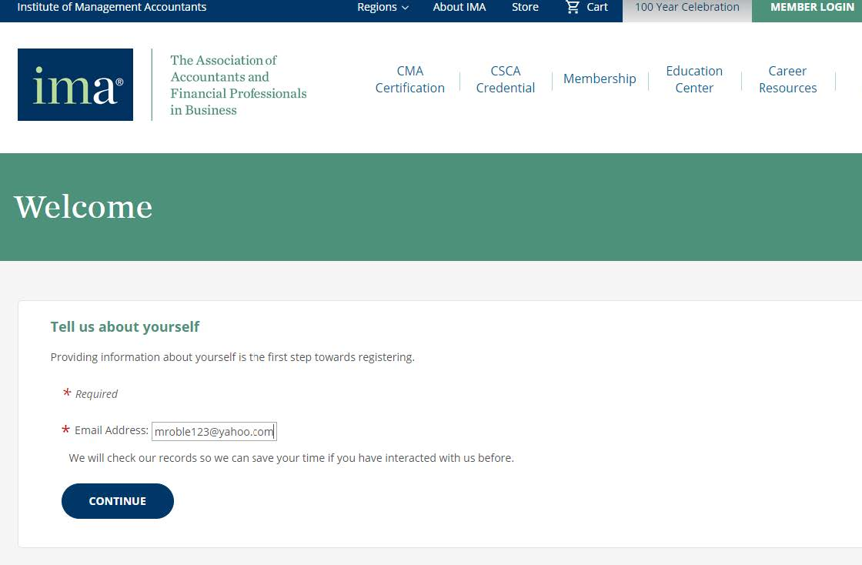
Step 3
Enter your email address,
then click continue.
Creating an IMA Customer ID | A step by Step guide

Slide 5
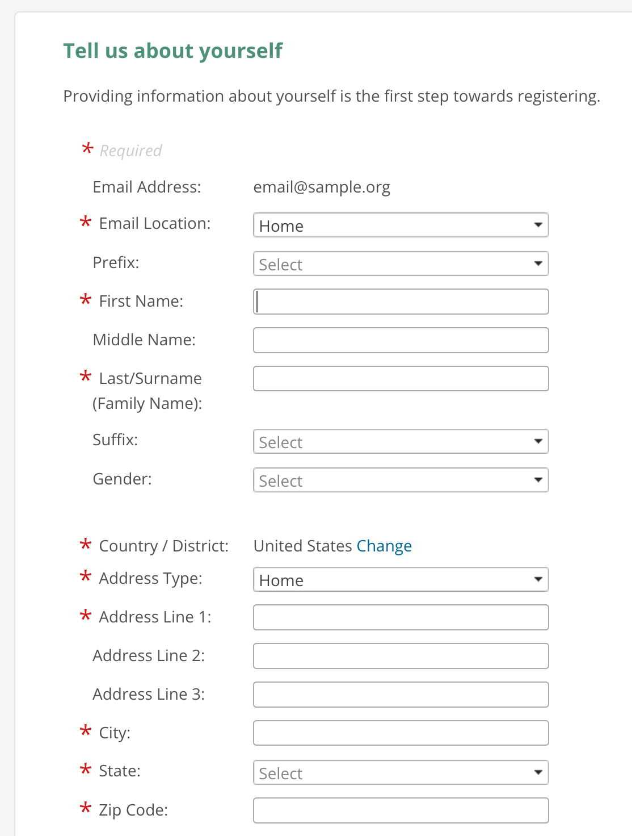
Step 4
Fill up the information marked with red asterisks(*), then create your password and agree to the privacy policy, terms and conditions, then click next.
Creating an IMA Customer ID | A step by Step guide

Slide 6
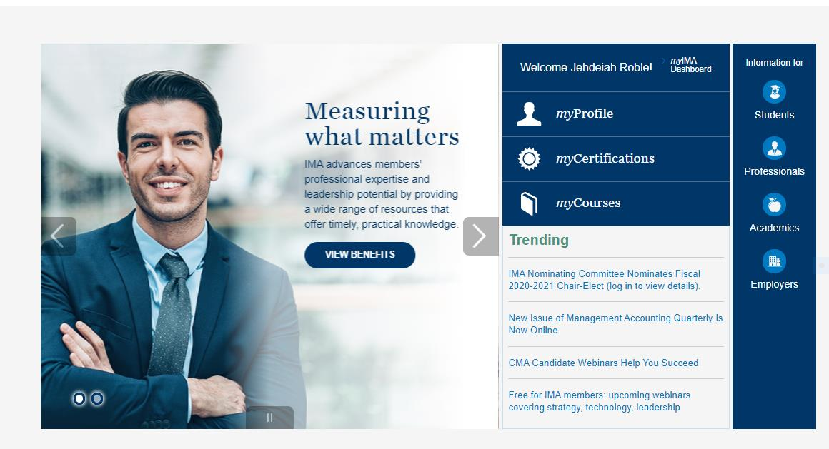
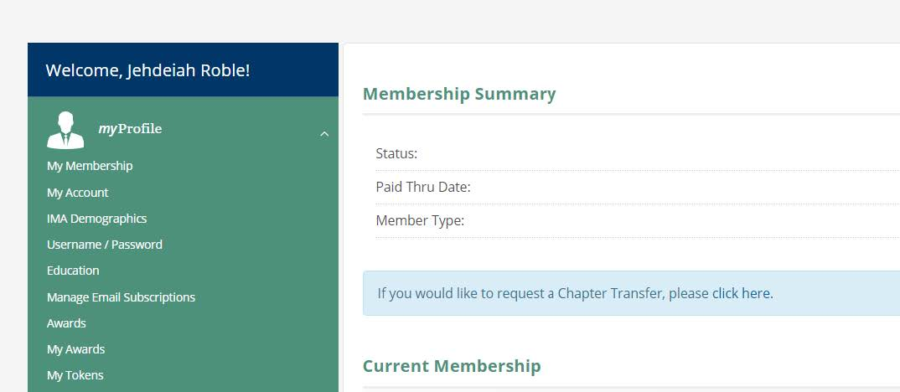
Step 5
a.
Click on myProfile
Go to my Account
Find your IMA customer ID number
b.
c.

Slide 7
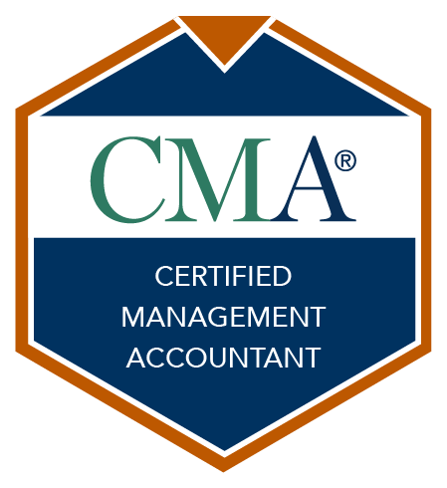
Step 6
Email your professor the following information:
IMA customer ID
Email you used to create your IMA Account
Anticipated Graduation Date
Major
For additional information or customer support, please contact:
IMAScholarshipAmericas@imanet.org
Creating an IMA Customer ID | A step by Step guide

