Slide 1
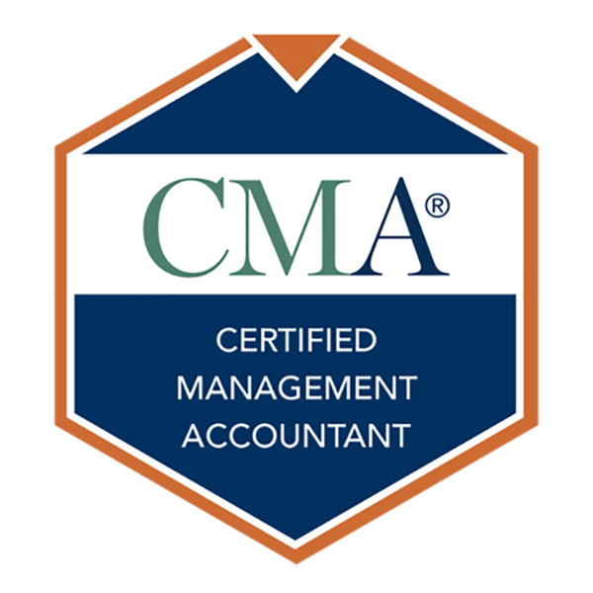
Your Career. Your Story. Discover the CMA Certification

Slide 2
Presenting Today
Insert Photo Here
Full Name, Credentials
Full Title
Contact details

Slide 3
Today’s Agenda
Careers in management accounting
What is IMA?
Gain an edge with the CMA
Steps to becoming a CMA
Q&A
Notes:
Here’s a quick overview of what I’ll be presenting today (READ LIST).
We’ll have time for questions at the end.

Slide 4
Careers in Management Accounting
Notes:
Let’s start with information on careers in management accounting.

Slide 5
Management Accounting & Public Accounting
Management Accounting
Public Accounting
Internal
External
Develop
Implement
Manage
Report
Audit
Tax
Management accountants support the creation of value, rather than simply measuring it.
Public accountants focus on compliance.
Relevant certification: CMA
Relevant certification: CPA
Global professional certification
Focuses on the future and on supporting strategy
License granted by a U.S. state
Focuses on historical data
Notes:
This picture helps to show the different roles and responsibilities of the internal management accountant as compared to the external public accountant.
The rectangle on the left represents the company or organization where the management accountant is employed. On a daily basis, the management accountant has responsibilities for developing, implementing, and managing processes within the company. They also get involved with both internal and external reporting.
The public accountant is an external accountant and will provide advice to their client on details related to audit and tax. They are not involved in daily operations or decisions that support the implementation of a company’s strategy. The main focus of their job is to ensure that the organization is complying with appropriate regulations and requirements.
I think you can see that the roles and the day-to-day job responsibilities for these two types of accountants are very different. Essentially, the management accountant helps the company to make money, while the public accountant helps the company to stay in compliance.

Slide 6
Management Accountant Jobs and Roles
Support business management and strategic development
VP of
Finance
Provide accurate information for better decisions
Government Organizations
Not-for-profit Organizations
Finance Manager
Controller
Execute budgeting and forecasting
Plan for the long term
Private Firms
CFO
Establish and maintain internal controls
Multinational Corporations
Act as trusted business advisors
Academic Institutions
Notes:
Take a look at this picture. It will show us where management accountants work, the titles they may hold, and the type of work they do.
Let’s start with the light green boxes. These are some of the titles that internal accountants might hold in the workplace. The titles included here are very high-level. Management accountants could also be cost analysts, accounting analysts, budget analysts, or financial analysts, for example.
[CLICK TO SHOW BLUE BOXES] Now let’s look at the blue boxes. These represent examples of work that management accountants are doing on the job. Budgeting and forecasting is a very common job responsibility for management accountants. They also get involved with supporting the decision-making process, analyzing company performance, and internal controls, among other things.
[CLICK TO SHOW GREY BOXES] Finally, the grey boxes represent places where you’ll find management accountants working. Basically, they’re working in all sorts of companies and organizations (read some of the grey boxes).

Slide 7
The Management Accounting Profession
More than 75% of accounting and finance professionals in the U.S. work inside organizations, building quality financial practices into the organization through decision support, planning, and control over the organization’s value-creating operations.
Source: Derived from U.S. Bureau of Labor Statistics
Notes:
This information is derived from the U.S. Bureau of Labor Statistics and it tells us that over 75% of accounting and finance professionals in the U.S. are working inside companies and organizations. The other 25% or so are working in professional services, such as your public accountants who support their clients with audit and tax advice.
It’s important to understand this, because:
If you start your career in public accounting, it’s very likely that within 3-5 years, you will move into a position in industry. IMA and the CMA can help you when you make that transition.
And if you start your career in industry, there are a lot of good opportunities available to you.

Slide 8
Future of the Profession
New technologies:
- Data & Analytics
- Artificial Intelligence (AI)
- Blockchain
Disruption to
accounting
profession
Management
accountants are
uniquely qualified
to manage this
change
Notes:
There are some big changes that are occurring in the profession. These changes will create great opportunities for professionals who are prepared for them and who see them as opportunities rather than challenges.
Data & Analytics knowledge needs to be a part of your skill set today.
Artificial Intelligence affects all businesses today and will have an even greater impact in the near future.
Blockchain technology is on the horizon.
What do the changes mean for you? IMA can help you prepare for these changes through certification, educational resources, and networking.

Slide 9
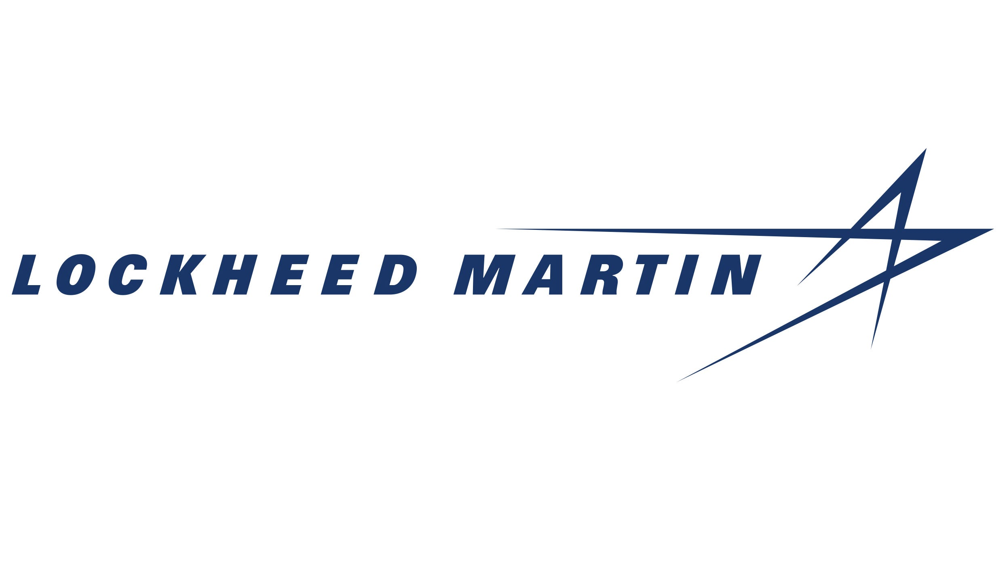
Where do Management Accountants Work?
Notes:
Management accountants are working in organizations of all sizes and in all industries.
All companies (publicly traded, privately held, not-for-profit, government, small business, etc.) need accounting and financial management professionals with good planning, budgeting, and decision analysis skills.

Slide 10
Diane Isibor, CMA Senior Financial Analyst – Supply Chain Deliver
Johnson & Johnson
Job role
I lead financial planning, reporting and analysis for the US and Canada Pharma business segment- Transportation and Warehousing. I also evaluate cost improvement projects, prioritization of investments and ensure SOX compliance.
How does the CMA benefit Diane?
The CMA certification gives me a better appreciation for the work I do. In my career, I have had exposure to Plant Finance, Sales and Service, Global Logistics and Distribution, Finance Systems and Corporate Financial Planning and Analysis. Taking the CMA early on in my career set me up for success in a variety of finance roles. It boosted my confidence and helped me become a well-rounded finance professional in industry.
Advice from Diane
Take advantage of the CMA scholarship and take the exam while in school!
Notes:
I’d now like to share with you a real-life example of someone who works as a management accountant. We first have Diane Isibor.
Diane is a CMA and works at Johnson & Johnson as a Senior Financial Analyst – Supply Chain Deliver. She leads financial planning, reporting and analysis for the US and Canada Pharma business segment- transportation and warehousing.
Diane also shares how the CMA certification has given her a better appreciation of the work she does and has helped her be successful in a variety of finance roles. I also like how she mentions the CMA has boosted her confidence and helped her become a well-rounded finance professional in the industry.
Her piece of advice is to take advantage of the CMA Scholarship and take the exam while you are still in school. We will be talking more about the CMA Scholarship later in the deck.

Slide 11
Michael Kelley, CMA, CPA Global Operations Manager Nike
Job role
I work cross functionally with Supply Chain and Finance functions that distribute and fulfill orders across our consumer construct. I conduct cost analysis and efficiency studies for distribution operations and implement new technology within the supply chain to fulfill orders faster and more sustainably. I also report on operational costs and shipping volumes monthly and create analytics that allow us to rationalize fulfillment speed and service levels.
How does the CMA benefit Michael?
The CMA benefits me directly by providing me several frameworks and methodologies for approaching costing and performance management.
Advice from Michael Dream big, have courage, and work hard. Make time for self-reflection and self-analysis and see if the work you are doing is getting the results you want. Take an honest look within yourself if your results aren't there. If you want to see a change, you must make a change.
Notes:
Next we have Michael Kelley
Michael is a CMA and CPA and works at Nike as a Global Operations Manager. He conducts cost analysis and efficiency studies for distribution operations, and implements new technology within the supply chain to fulfill orders faster and more sustainably.
The CMA certification benefits Michael by providing him with several frameworks and methodologies for approaching costing and performance management.
His piece of advice is to do some self-reflection. If you want to see a change, you must make a change.
The two profiles we showed are just two examples of the many types of job opportunities that are out there for management accountants.

Slide 12
What is IMA?
Notes:
I’d now like to tell you a bit about IMA, the Institute of Management Accountants.

Slide 13
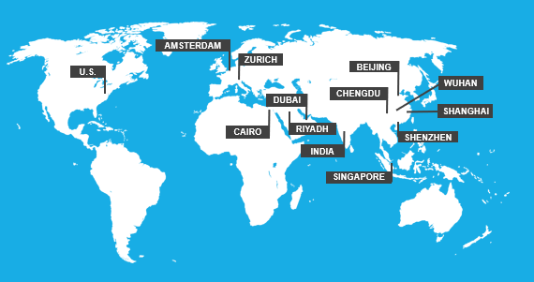
Institute of Management Accountants
A global network of more than 125,000 members worldwide and more than 300 student and professional chapters
4 regions and 13 global offices
Offers a globally recognized certification: CMA® (Certified Management Accountant)
Notes:
IMA is a global association with more than 125,000 members who are accounting and finance professionals working in business.
Our organization has more than 300 professional and student chapters, located in cities and campuses around the world – this creates a great networking opportunity.
IMA also offers the CMA certification, the global standard in management accounting, in addition to many other career-enhancing resources.

Slide 14
IMA Student Membership Benefits
Valuable leadership experience
Reduced membership and CMA fees
Connect with professional and student members
Student Membership Benefits
Competitions, scholarships, and award programs
IMA’s Student Leadership Conference
Free professional development courses to get you career-ready
Notes:
IMA has a lot to offer its student members.
There are more than 130 student chapters and 200 professional chapters around the world. So, I encourage you to connect with your local IMA chapter
which offers a great opportunity to develop leadership skills and a professional network.
IMA holds an annual Student Leadership Conference where more than 600 students, faculty, speakers, and sponsors gather for a fantastic professional development and networking event. This year the event is planned to be held in Detroit, MI from November 9th-11th. We will talk a little bit more about that towards the end of the presentation.
More than $30,000 is awarded each year in scholarships. Be sure to check the IMA website for details about the various scholarships, their requirements and due dates. We will also talk about our Student Case Competition later in the presentation where you could win a trip to compete at IMA’s Annual Accounting & Finance Conference against other schools and win a cash prize!
IMA offers reduced membership and CMA-related fees for students.
IMA also offers free professional development courses (or continue professional education, CPE) to help get you career-ready. This includes courses on technology, soft skills, leadership, and more.

Slide 15
Free IMA Learning Opportunities for Students and Academics
Access these courses and more at imanet.org/cpe
Notes:
There are two IMA courses that I would like to highlight that are offered for free to student and academic members.
You can take the Data Analytics & Visualization Fundamentals Certificate AND the RPA Series at no cost. It is included with your membership. Upon completion of the courses, you will receive a certificate of completion, along with a digital badge that you can post to LinkedIn. This is a really great way to stand out and show that serious about your career.

Slide 16
Connect with Your Local IMA Chapter
Why should you join your local IMA Chapter?
Network with like-minded peers, diverse talent and supportive peers in the accounting/finance profession
Access career opportunities and valuable business connections
Stay informed and involved with the world of management accounting
{Insert Chapter Website}
Add upcoming chapter events
Leadership opportunities
Scholarships/funding
Contact info
*Delete text box if this does not apply to you*
Notes:
We talked a little bit about local IMA chapters on a previous slide but wanted to help you understand the benefits of connecting with the chapters and members.
READ SLIDE – USE EXAMPLES IF YOU HAVE THEM

Slide 17
Gain an Edge with the CMA
Notes:
Now let’s talk about the CMA certification.

Slide 18
What is the CMA?
Globally recognized professional certification in management accounting
Focuses on advanced skills in accounting and financial management such as financial planning, analysis, control, and decision support
Enhances strategic thinking: CMAs can explain the "why" behind the numbers
Notes:
The CMA is a globally-recognized certification not a license, that is granted by a U.S. state. Someone sitting for the CMA in the U.S. is sitting for the same exam as someone in China, Dubai or the Netherlands, for example.
The CMA covers the critical skills and knowledge that accounting and financial management professionals need to be successful in their careers.
CMAs are trained to be strategic thinkers. They interpret financial information and provide guidance to senior management to support the company’s strategy.

Slide 19
CMA Exam Structure
Part 1: Financial Planning, Performance, and Analytics
Part 2: Strategic Financial Management
External financial reporting decisions
Planning, budgeting, and forecasting
Performance management
Cost management
Internal controls
Technology and analytics
Financial statement analysis
Corporate finance
Decision analysis
Risk management
Investment decisions
Professional ethics
Each exam part is 4 hours long:
100 multiple-choice questions, followed by two 30-minute essay scenarios.
Notes:
The CMA exam is composed of two parts – testing your fluency in both accounting and finance.
The exams are each four hours in length, starting with 100 multiple choice questions and concluding with 2 essay scenarios, which are like mini cases. The exam parts can be taken in any order.
This slide provides a high-level overview of the test topics. (more details are available on the IMA website). Does any of this look familiar to you?
The Part 1 exam is called Financial Planning, Performance, and Analytics, and it has 6 sections.
The first section focuses on External Financial Reporting Decisions and it covers financial accounting topics, similar to what you would learn in your intermediate financial accounting courses.
The next three sections (Planning, Budgeting, and Forecasting; Performance Management; and Cost Management) cover topics that you would learn in your cost or managerial accounting courses, such as the master budget process, variance analysis, Balanced Scorecard, job-order costing, Activity-Based costing, etc..
The fourth section covers best practices in Internal Controls.
The final (sixth) section, is called Technology and Analytics. This section covers content related to accounting information systems, including topics such as data governance, technology enablement, and data analytics.
The Part 2 exam is called Strategic Financial Management. It has 6 sections and you’ll see that it includes some finance topics.
Financial Statement Analysis focuses on financial ratios (liquidity, profitability, turnover, etc.). You’re expected to calculate the ratios and interpret them. For example, how is your company trending over time? How does it compare to competitors in the industry?
Corporate Finance focuses on risk and return models, and financial instruments.
Decision Analysis covers things like variable and fixed costs, cost/volume/profit analysis, and contribution margin income statements.
Risk Management focuses on best practices in Enterprise Risk Management. Companies need to be prepared to managing risks by identifying them and creating plans to defer, transfer or even avoid them.
The Investment Decisions section covers capital budgeting techniques like discounted cash flow methods (NPV, IRR) and other ways to evaluate investments for an organization.
And finally, the last section focuses on Professional Ethics. Ethics is such an important topic to IMA as well as to the profession. We cover IMA’s Statement on Ethical Professional Practice in this exam section.
The content covered on the CMA exam is very relevant. If you were to show this list of topics to a senior leader in finance or accounting, they would tell you that they need employees who have a mastery of these skills.

Slide 20
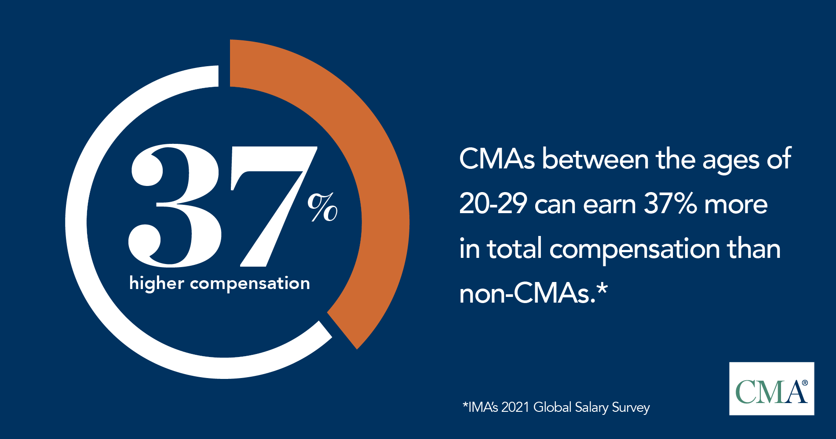
The Difference is in the Numbers
Notes:
Each year, IMA conducts a Salary Survey of its members, and accounting and finance professionals from the U.S. In 2021, the survey showed that in the U.S. CMA certified accounting professionals between the ages of 20-29 earn, on average, 37% more in median total compensation than their noncertified accounting peers.
Now keep in mind that this doesn’t mean that you will automatically receive a 37% pay increase when you earn the CMA! The skills and knowledge that you acquire as a result of the CMA -- along with hard work, excellent performance, and strong ethics – will help you to become a high achiever and you can be rewarded over time with a higher salary.
The message from this survey is that CMA certification provides a positive return on investment. It’s worth your while to become a CMA.

Slide 21
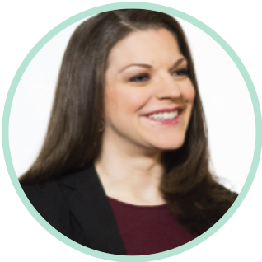
Praise for the CMA
“Financial analysis and decision support are central to the management accounting practice, and the CMA focuses on these areas.”
–David Burritt, CMA President and CEO, U.S. Steel
“Thanks to the CMA, I truly understand what my clients need on a daily basis.”
–Ashley B. Gibson, CMA, CPA Digital Finance Senior Manager, Accenture
“For a large multinational company like J&J, the CMA provides a breadth of subjects that prove, once you’ve earned the certification, that you’re both knowledgeable and competent.”
–Christian Cuzick, CMA
2019-2020 Chair, IMA Global Board of Directors
Vice President of Finance,
Johnson & Johnson Vision
Notes:
I’ll let you read through some of the testimonials here.

Slide 22
Students Like You Are Pursuing the CMA
Notes:
Student videos:
If you are able to access the internet during your presentation to play this video, then please play it during the presentation.
If you are not able to access the internet during your presentation, then please use the next slide in lieu of the video.

Slide 23
Young Professionals Who Pursued the CMA
“In public accounting, everyone has a CPA, but having the CMA in addition to the CPA distinguishes me from my peers.”
Adam Milano, CMA, CPA M&A Advisory- Manager Deloitte
“I earned the CMA certification at a very young age, and that helped me have the confidence to move across different industries and roles when I had the opportunity.”
Fatema El-Wakeel, CMA Global Data Platform Leader - Data Analytics COE
Unilever
“The CMA certification opens the door to a whole new world of accounting, beyond just tax and audit, where you can help influence a business to drive it to greater things and greater results than would otherwise be possible.”
Eric Mauer, CMA Finance Manager
Cummins Inc.
Notes:
Here are a few testimonials that I’d like to share with you.

Slide 24
Steps to Becoming a CMA
Notes:
Okay, so what do you need to do to become a CMA?

Slide 25
Program Requirements
Completion of two exams
Bachelor’s degree from an accredited college or university (in any major)
Two years of relevant work experience
Active membership in IMA
Notes:
In order to become a CMA, you have to pass the two exam parts, as well as fulfill the education and work experience requirements.
The education requirement states that you must have a bachelor’s degree from an accredited college or university. The degree can be in any major, however, most CMA candidates hold degrees in accounting or finance. Candidates are not required to have already earned their degree in order to sit for the CMA. Often, students will sit for the CMA prior to graduation. Candidates just need to complete their degree within 7 years of passing the CMA exam parts.
As for the work experience requirement, candidates need to complete two years of professional work experience in order to become a CMA. A complete explanation of the types of positions that would fulfill the work experience requirement are listed in the CMA Handbook on the IMA website. In general, work experience that requires analysis will qualify, but internships and jobs that are clerical in nature would not fulfill the work experience requirement.
To maintain the CMA certification, CMAs are required to maintain their membership with IMA and to complete 30 hours of continuing professional education (or CPE) each year. Of the 30 hours, at least 2 hours must be in ethics training.

Slide 26
Exam Testing
Exam is administered at Prometric Testing Centers worldwide (check website for details)
Three exam testing windows offered each year:
January and February
May and June
September and October
Candidates schedule exams at their own pace:
Part 1 and Part 2 can be taken in any order
On average, candidates complete the program within 12-18 months
Check Prometric testing site to review guidelines, policies, etc., ahead of time!
Notes:
The exam is computer-based and is taken at Prometric Testing Centers
There are 3 “testing windows” offered each year. These are the only months when the CMA exam can be taken. If this is something you want to persue I would take a look over the next year or so and start planning out when you think you might be able to sit for the exam. Take into consideration travel plans, work, family, etc. Figure out which testing window you want to sit and sort of work backwards figuring out how much time you want to study each week, so you can break down the study time to prepare for the exam.
Parts 1 and 2 can be taken in any order. A lot of people like to take part 1 first because it seems natural to follow the order, but you can start with either. If you feel that you are more of an accountant and that is your strength, start with part 1. Play to your strengths. Part 2 has a bit more finance content, so if you feel like you are more of a finance person, you can start with part 2. They don’t build on one another.
CMA candidates schedule the exams on their own and at their own pace. Some candidates will try to complete the exam very quickly (perhaps one exam per testing window or both exams within one year), while others will take more time.
On average, most people take about 12-18 months to complete the two exam parts. As students you are at a bit of an advantage because the content is very relevant to what you are learning in the classroom and very fresh to you.

Slide 27
IMA Membership
Become an IMA member
Professional members: $275/year + $15 one-time processing fee
Students members: $45/year*
2) Pay the CMA program entrance fee
Regular members: $280 one-time fee
Student members: $210 one-time fee
3) Register to sit for an exam part
Regular members: $460 per part
Student members: $345 per part
SPECIAL IMA OFFER ON WEBSITE: Join for just $25 per year!
USE CODE: STU25
IMA WEBSITE: www.imanet.org
Notes:
There are some administrative fees associated with becoming a CMA.
The first step is to join IMA. IMA offers a student membership which is very affordable, at just $39 per year. If you use the coupon code STU25 on our website, you can reduce the membership fee to just $25 per year.
To pursue the CMA, the next step is to declare yourself a CMA candidate. You do that by paying the CMA Program Entrance fee. For students, the fee is just $188.
Finally, once you’re ready to sit for an exam, you will register for a specific exam part and a specific testing window and pay the Exam Part Fee. Student members receive an automatic 25% discount off of the regular exam fee. (Note: No code is required for students to get the discounted exam registration fee. The IMA system will automatically give them that rate as student members.)
Even if you aren’t ready to commit to the CMA program at this time, we encourage you to join IMA now to take advantage of numerous membership benefits.

Slide 28
CMA Scholarship Program
IMA provides 5 scholarships annually to non-IMA Endorsed Schools and 10 scholarships to IMA-endorsed schools, which covers all expenses associated with the CMA program.
Students must be nominated by a faculty member at your school
Included with the CMA scholarship at no cost:
3 years of IMA Student Membership
Entrance into the CMA Exam Program
Two CMA Exam sitting fees
1 year of access to Gleim CMA study materials
Take the exam while you are still in school!
More than $2,000 in value
Notes:
The next thing I want to talk about is a really great program IMA has to offer, the CMA Scholarship Program. IMA offers 5 scholarships per year to non-IMA Endorsed Schools and 10 scholarships to IMA endorsed schools, covering all costs related to the CMA program.
The CMA Scholarship is available to all accounting/finance students. In order to receive the scholarship, students must be nominated by a faculty member. That’s really the only stipulation there is with this program.
Now included with the CMA Scholarship:
Students will receive three years of IMA membership
The entrance fee into the CMA Program will be covered
Registration fees for both parts of the exam will also be covered
1 Year of access to Gleim CMA Study Materials
It’s easily more than $2,000 in value. Make sure you let your professors know you are interested in this.

Slide 29
Why Take the CMA Exam Now?
Students can take the CMA exam before graduation
The CMA exam tests topics you study in college courses
Students are more efficient studiers than professionals who have been out of school for many years
IMA offers reduced membership and CMA exam-related fees for students
If you are looking for an advanced certification
to build your skills, resume, and earning potential –
the CMA is the right choice!
Notes:
In closing, I’d like to sum up some of the reasons you should consider pursuing the CMA
First, you can sit for the exam while you’re still a student. You just have to earn your bachelor’s degree within 7 years of passing the exam.
This exam is drawing much of its content from courses that you have recently taken. You may need to refresh your knowledge of some topics, but you won’t have to completely re-learn the topics.
As students, you’re much more efficient at studying; you know where to go to focus and how to effectively study. Once you are out of school for a while, you lose that ability and it takes a lot longer to prepare and study for exams!
Students can take advantage of the reduced student rates for IMA and CMA fees
I hope that you’ve found this presentation to be informative and helpful. If you’re looking for a way to differentiate yourself, enhance your skills and earning potential, you should consider the CMA.

Slide 30
Get Career Ready with IMA
Join IMA - $25
(use code: STU25)
Talk to your professor re: CMA Scholarship
Study and pass the CMA exam
Graduate and get relevant work experience
Add “CMA” to your business card!
Notes:
We’ve covered a lot of information in this presentation, so I’d like to leave you with a simple checklist.
Start by joining IMA today! You’ll receive all the benefits of IMA membership and will take your first step toward CMA certification.
If you’re serious about enhancing your career, you can take and pass the CMA exam before you graduate. After just two years of relevant work experience you’ll be able to add “CMA” to your business card.
Imagine the possibilities! Remember, it’s “Your Career. Your Story.”

Slide 31
Student Events

Slide 32
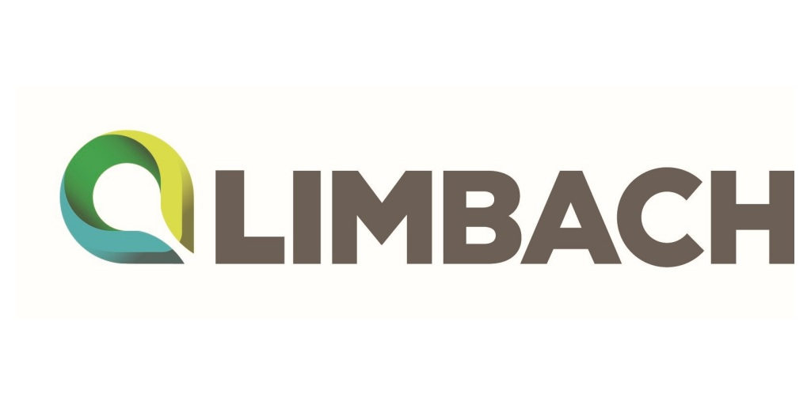
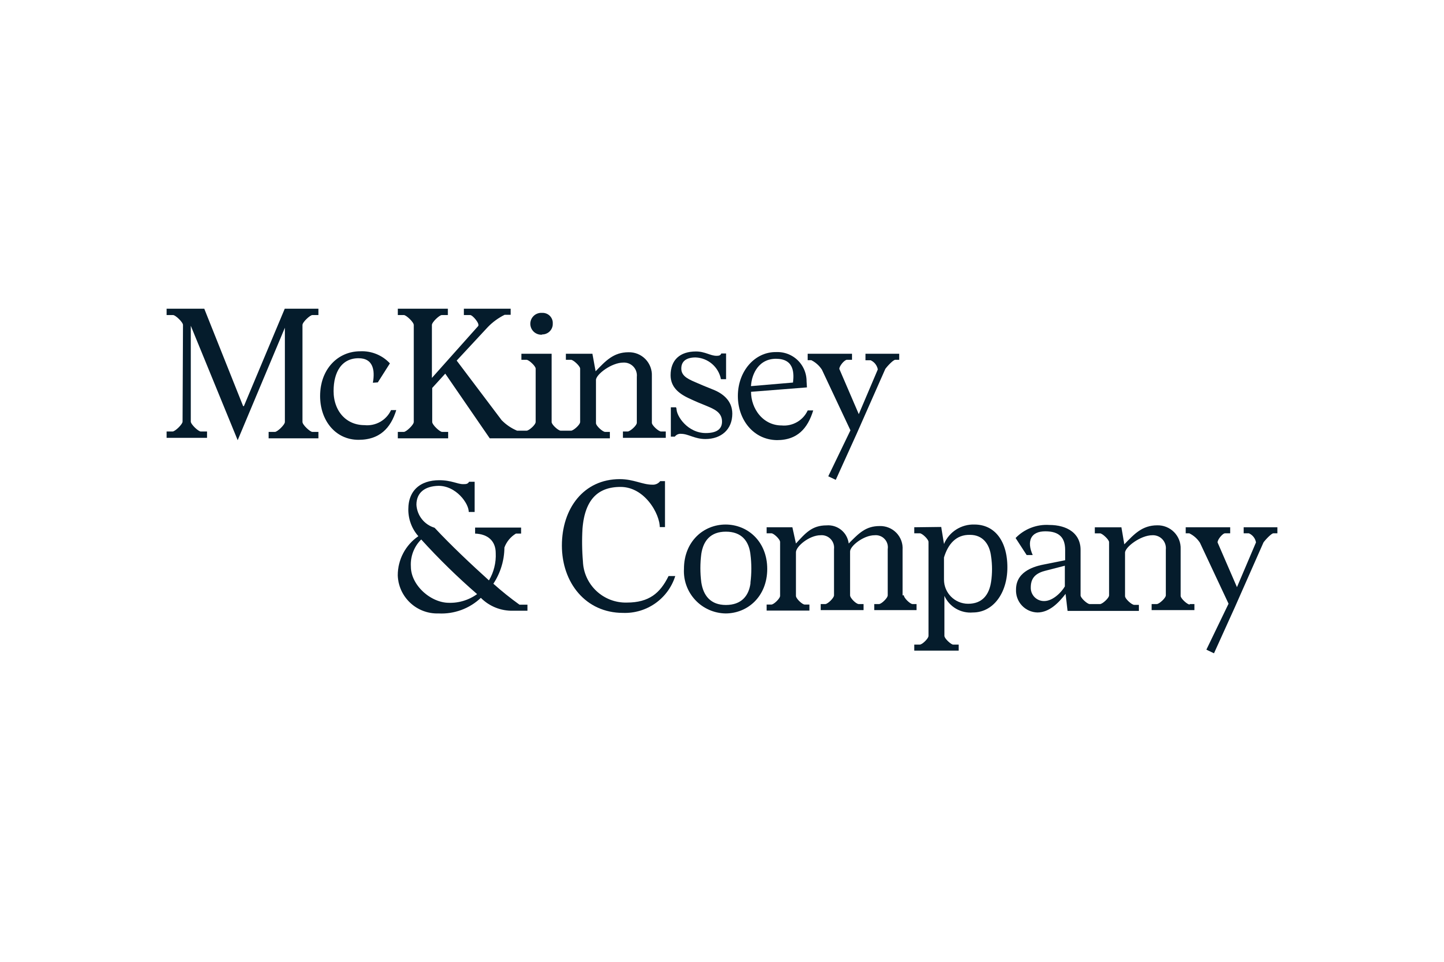
IMA Student Series: Finance & Accounting Professional Panel
Next Webinar: October 10, 2023
7-8pm EDT
Join us for a virtual panel of successful professionals representing a variety of industries and diverse backgrounds!
Learn about:
Career paths in management accounting
CMA Certification
Career advice for young professionals
Notes:
We're excited to invite you to join us on October 10th for IMA’s Student Series: Accounting and Finance Professional Panel, featuring successful young professionals from various industries. Our panelists come from diverse backgrounds, providing a unique perspective on their respective career paths. In this session, you'll have the opportunity to learn about their experiences, gain insights into the world of management accounting, explore the benefits of CMA certification, and receive valuable career advice.

Slide 33
Notes:
Be sure to join us for IMA’s Student Leadership Conference from November 9th-11th in Detroit, Michigan. Students will have the opportunity to hear from top accounting and finance professionals, tour industry sites to learn about accounting operations, network with like-minded peers and professionals, and explore internship and job prospects in our exhibit hall. Don't miss out on this empowering event to elevate your leadership skills. Registration opens September 5th.

Slide 34
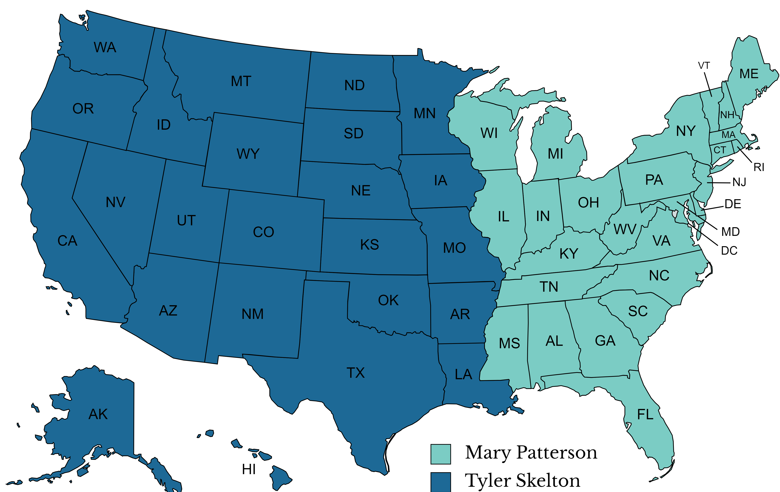
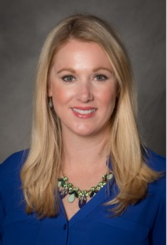
Do you have more questions or would you like a copy of this PowerPoint deck?
Contact your IMA Representative today!
Tyler Skelton
Academic Outreach Manager, Western US
Tyler.Skelton@imanet.org
Mary Patterson
Academic Outreach Manager, Eastern US
Mary.Patterson@imanet.org

Slide 35
Q&A

Slide 36
Appendix Answers To Frequently Asked Questions (Reference for presenters)

Slide 37
Appendix- Work Experience Requirement
From IMA’s CMA Candidate Handbook:
Candidates for the CMA Certification must complete two continuous years of professional experience in management accounting and/or financial management.
This requirement may be completed prior to or within seven years of passing the examination.
Academics can meet this requirement if at least 60% of their course load is in accounting and corporate financial management courses above the principles level.
Professional experience is expected to be gained in full-time employment. However, continuous part-time positions of 20 hours per week meeting the definition of qualified experience will count toward this requirement at a rate of one year of experience for every two years of part-time employment.

Slide 38
Appendix- Work Experience Requirement (continued)
From IMA’s CMA Candidate Handbook:
Qualifying experience consists of positions requiring judgments regularly made employing the principles of management accounting and financial management. Such employment includes: • Preparation of financial statements
• Financial planning & analysis
• Monthly, quarterly, and year-end close
• Auditing (external or internal)
• Budget preparation & reporting
• Manage general ledger and balance sheets
• Forecasting
• Company investment decision making
• Costing analysis
• Risk evaluation

Slide 39
Appendix- Work Experience Requirement (continued)
From IMA’s CMA Candidate Handbook:
Employment requiring the occasional application of management accounting principles such as in computer operations, sales and marketing, manufacturing, engineering, personnel, and general management will not satisfy this requirement. Internships and trainee, clerical, or non-technical positions do not provide appropriate experience to fulfill this requirement.

Slide 40
Appendix- Dual Certification

